Slide 1
Personal Computing
EN1301
Word Processing Applications (12 hrs.)
Part 2

Slide 2
PART 2
Topics to be covered
  Creating a Booklet
  Mail Merge
  Document Collaboration
  Working with Macros
  Advanced Writer Options.

Slide 3
Creating a Booklet
Before start creating a booklet you must master
  Styles & Templates
    Ref3: p 171 – p 228 & p 290- p 299
  Page formatting & section breaks
    Ref3: p 102 -p 144
  Table of content, indexes & bibliography
    Ref3: p330 – p361
  Working with master documents & fields
    Ref3: p362 - p405

Slide 4
Creating a Booklet
Open “Exercise5_Booklet.odt”
Open “Exercise5_BookletAns.pdf”
Format the writer document as in pdf.
HINT

Slide 5
Creating a Booklet
In this exercise you will learn how to
  insert a first page.
  number the pages.
  insert a page footer.
  add headings.
  number figures and tables.
  work with footnotes.
  add cross referencing.
  change styles & formatting.
  insert table of contents...etc

Slide 6
Mail Merge
What is “Mail Merge”?
  What might be the answer?
  Guess
Read the following Chapter and answer the above question.
  Ref3: p 301– p 329
  Check your guessing

Slide 7
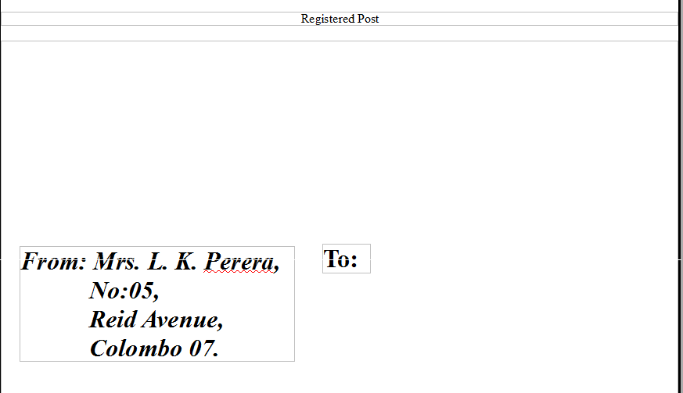
Mail Merge
Design the following envelop using “insert→envelop” option.

Slide 8
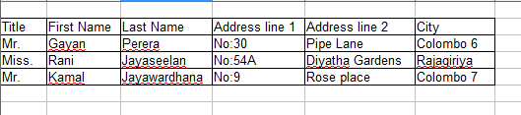
Mail Merge
Create the following data source using mail merge wizard.

Slide 9
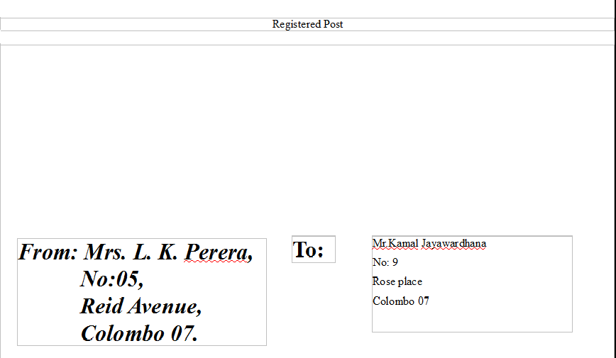
Mail Merge
Use mail merge wizard to personalize an envelop for each person in the data source.
An example is as follows.

Slide 10
Mail Merge
Challenge: Use Mail merge and design / create
  invitation cards
  Letters
for several recipients.

Slide 11
Document Collaboration
Ref3: p92 – p97
Open “Exercise6_Mammals.odt”
Go to “ Edit →Changes →Record”
Start formatting the document as shown in the next slide.

Slide 12
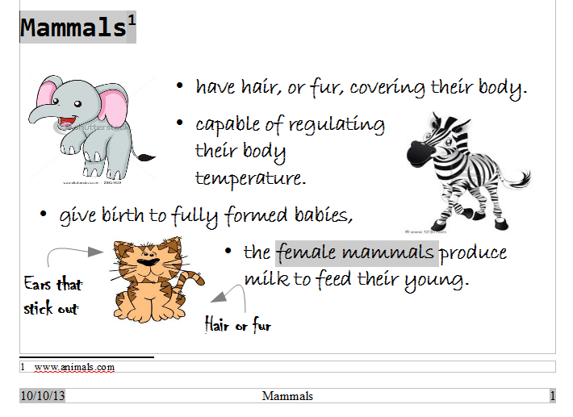

Slide 13
Document Collaboration
Noticed any difference?
It is because you are recording the changes.
Now go to “Edit →Changes →Accept or Reject”
Accept or reject the changes you have made to the document.
Challenge: Try out adding comments.

Slide 14
Working with Macros
a shortcut to a task you do repeatedly.
Consider “Align Right” operation
How can you align paragraphs in OO.org Writer?
  Two main ways
    Select the paragraph. Go to Format→Paragraph→Alignment Right→OK
    Select the Paragraph. Click “Align Right” button on the tool bar
Number 2 is an example for a macro.

Slide 15
Working with Macros
Open the file “Exercise7_Macro.odt”
Write a simple macro to do the following font formatting.
  Font: Arial Black, Font typeface:Bold & Italic, Size: 22, Underlining: Single, Character spacing:expanded by 3pt.
Format the document as shown in the next slide

Slide 16
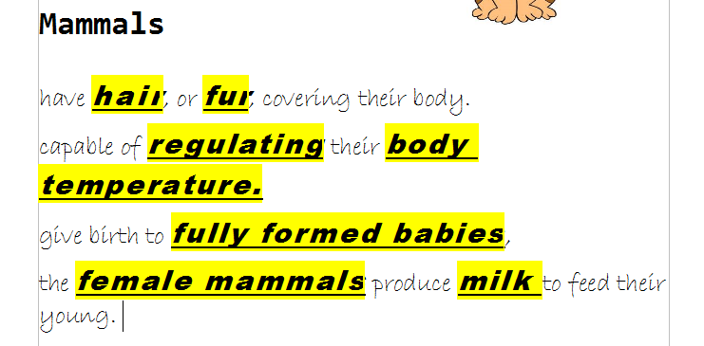
Working with Macros
HINT

Slide 17
Working with Macros
Select the word “hair”
Go to “Tools→Macros→Record Macro”
Select the following character formatting.
  Font: Arial Black, Font typeface:Bold & Italic, Size: 22, Underlining: Single, Character spacing:expanded by 3pt.
Click “Stop Macro” on the Record Macro tool bar.
Save the macro.
Now select the words that needs applying the above formatting. (Press Ctrl To Select)
Go to “Tools→Macros→Run Macro”
Select the macro and click Run.

Slide 18
Advance Writer Options
Try out the following.
  Working with security settings
  Changing language settings
  Key board shortcuts
Ref2: p 31 – p 54
Ref3: p 433 – p 457

Slide 19

END of Section 2
By now you are an EXPERT in
  Word Processing
  CONGRATULATIONS!
Reflect on
  What you can do???
Next Section
  Spreadsheet Applications

Slide 20


